Slide 1

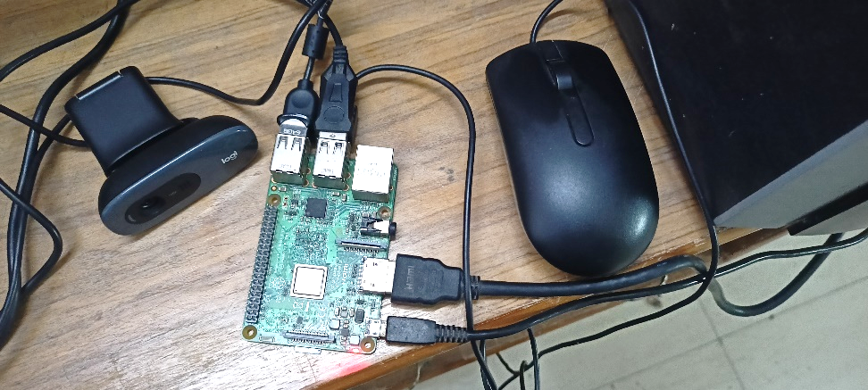
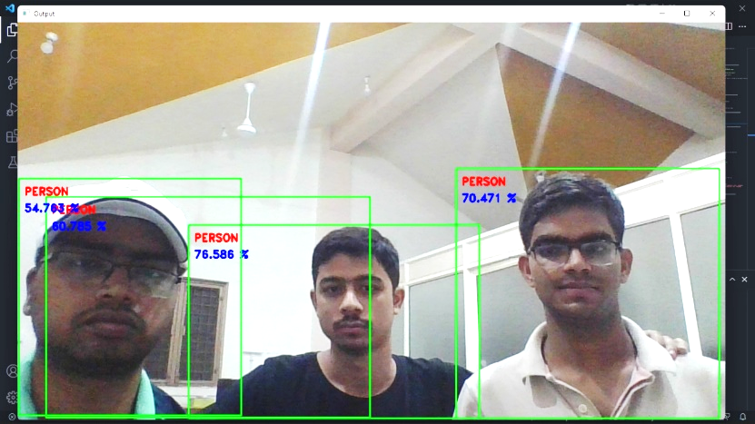

Real-Time Object Detection and Face Recognition on Raspberry Pi
INDIAN INSTITUTE OF TECHNOLOGY ROORKEE
Eklavya Kumar (20116032)
Ritik Madan (20116078)
Jatin Kumar (20116041)

Slide 2
Contents
Introduction
Training Deep Neural Network for Object Detection
Convolution Neural Network (CNN)
Open-CV and Code
Hardware configuration
Results
Future Works

Slide 3
Introduction
Computer vision enables the machines to process and analyze digital images and videos. One of the major application of computer vision is object identification.
Object detection is done using Artificial Neural Networks (ANNs).
A Neural Network is a mathematical function. It is defined by a bunch of neurons or nodes connected to each other in form of layers.
Neural Networks are trained with a large dataset (like images)
to predict the objects, present in the input with high accuracy.
Our aim is to propagate the real time video frames through a trained network to detect the objects present on the frame.

Slide 4
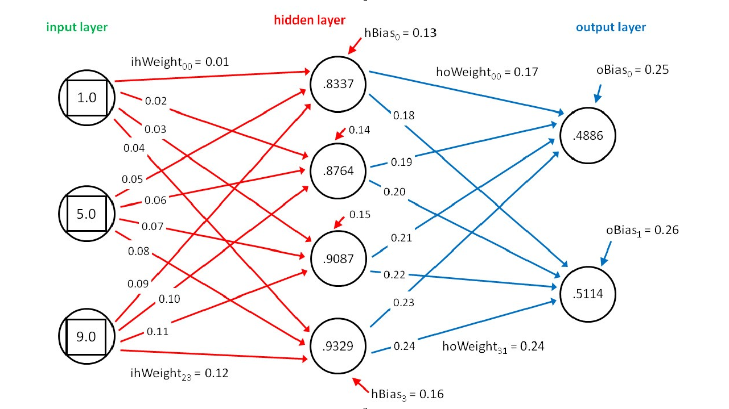
Training Deep Neural Network for Object Detection
Three types of layers in a Neural Network
Deep Neural Network (DNN) has high depth i.e., multiple hidden layers
For training we propagate through the network and predict the result based on the weight values
We use the error obtained in the prediction to adjust the weight values during back propagation.

Slide 5
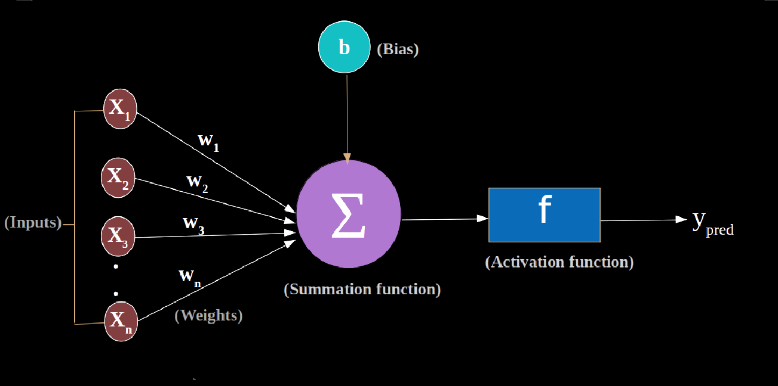
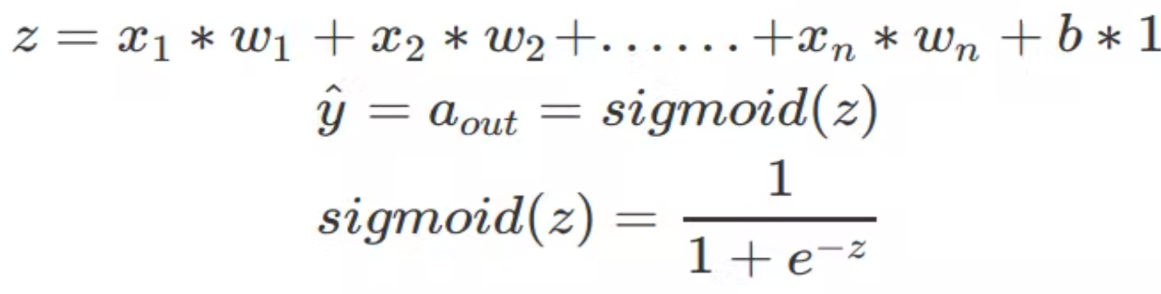
Steps involved in training the network
Propagation through the layers to predict the result
1. Product of weights with node values
2. Summation of products, add the bias
3. Pass the result through activation function

Slide 6
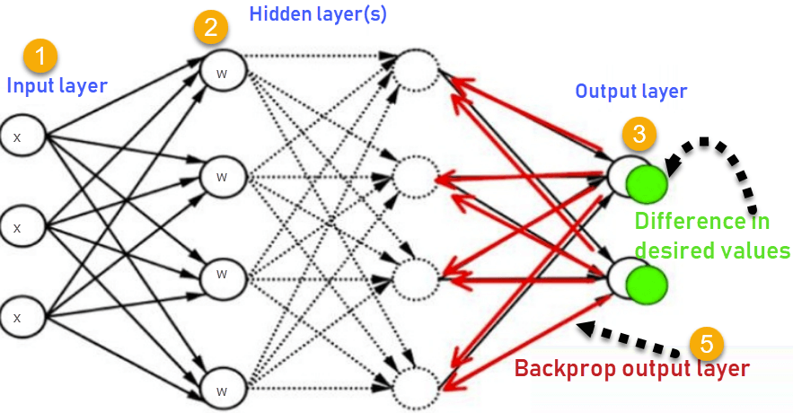
Steps involved in training the network
Loss function:
The prediction error is defined by loss function.
Backpropagation:
Distribution of the prediction error to update and optimize the weight values. The rule for updating weights on each iteration of Gradient Descent is the following:

Slide 7
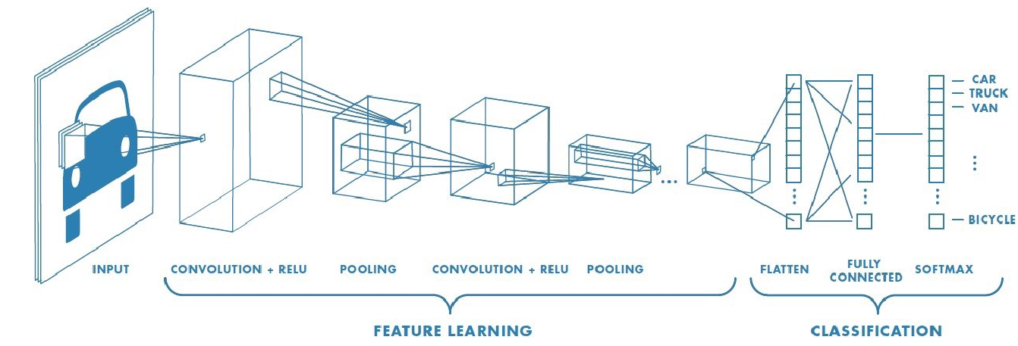
Convolution Neural Network (CNN)
The models are trained on CNN.
CNN uses simple architecture of where every hidden layers three sub layers.
(Convolution layer + ReLU layer + Pooling layer)

Slide 8

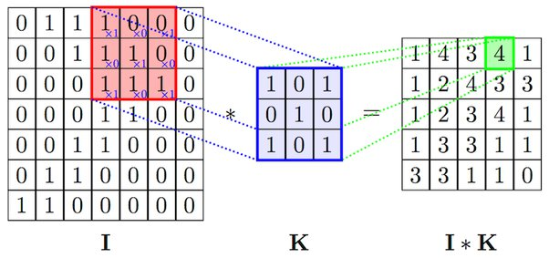
Convolution layer
The input layer is convoluted with a filter kernel to obtain the convoluted layer.

Slide 9

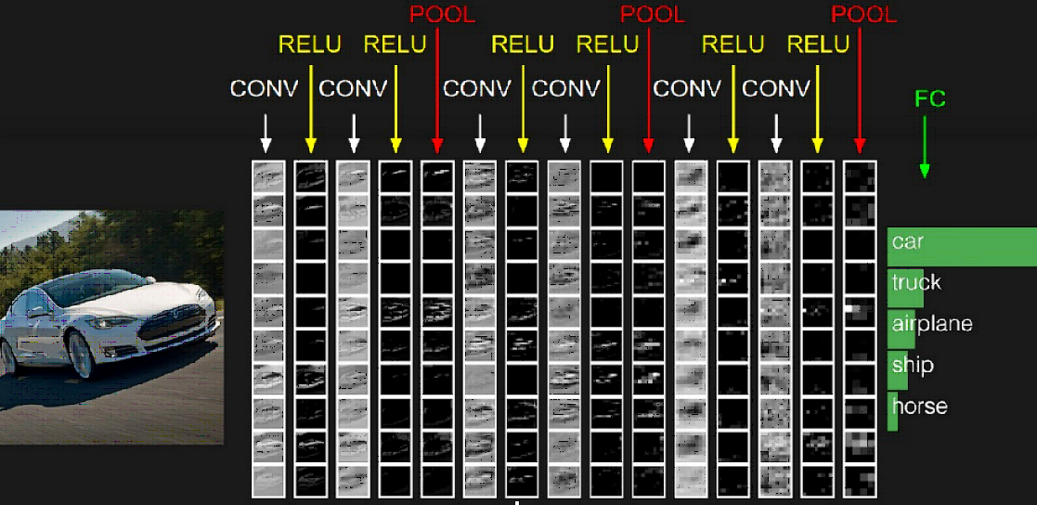
ReLU and Pooling
ReLU Function:
F(x) = max(x,0) → replaces the negative values to 0
Pooling Layer
The layer is further is reduced using pooling. There are two types of pooling
techniques.

Slide 10
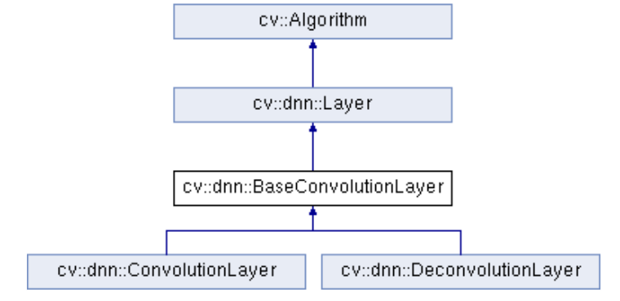
Open-CV and Code
Open-Source Computer Vision Library: It is a huge open-source library which makes contains tools that makes our life easier while dealing with techniques like object detection, image recognition.

Slide 11
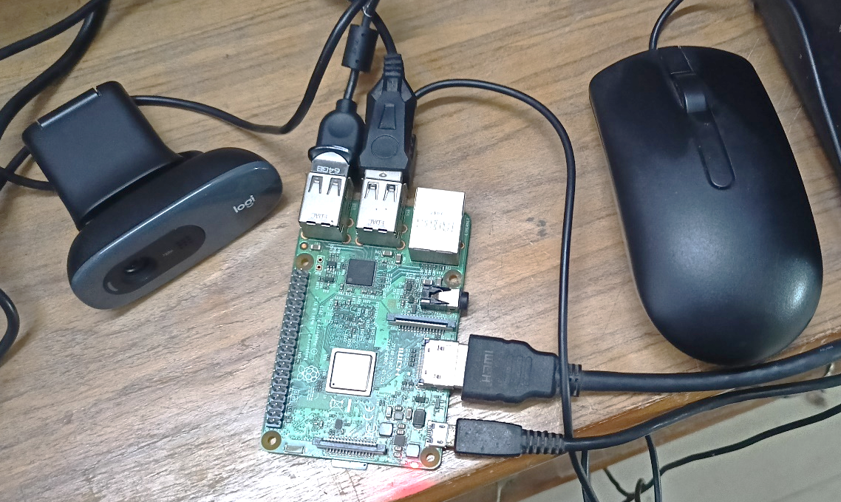
Hardware configuration
The hardware implementation is done in Raspberry pi embedded system for Real-Time Object Detection using a live video feed from a webcam interfaced with raspberry pi.

Slide 12
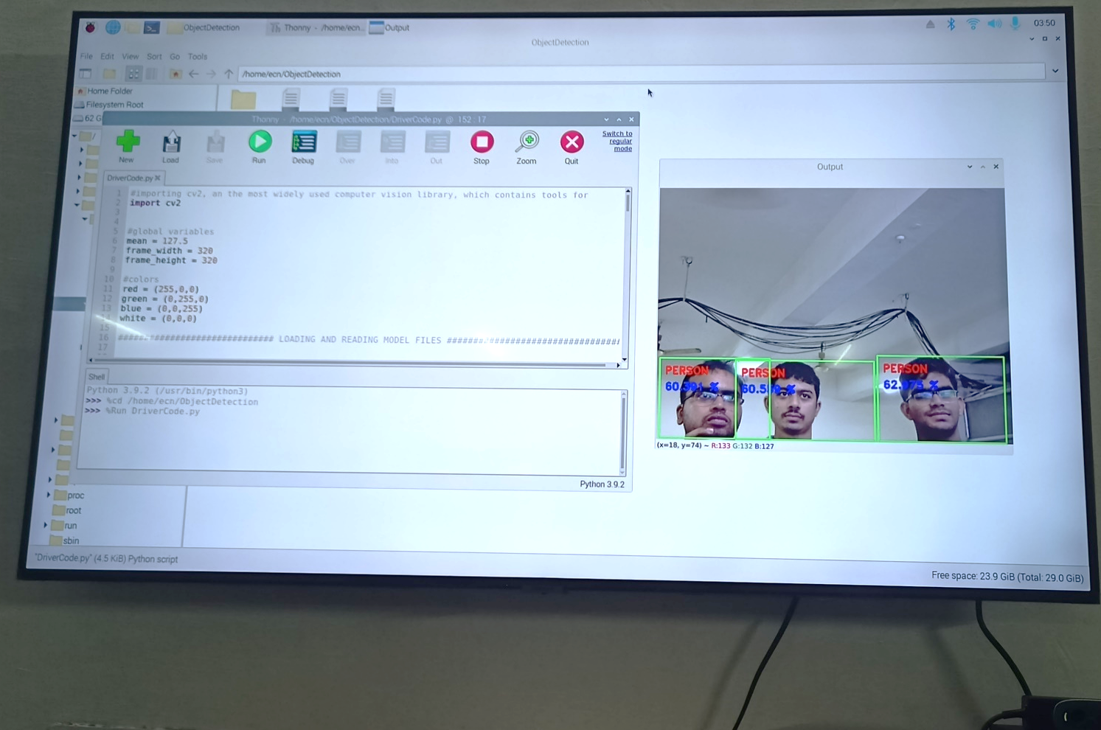
Results
We have successful tested our Embedded system for object detection in live video feed raspberry pi.

Slide 13
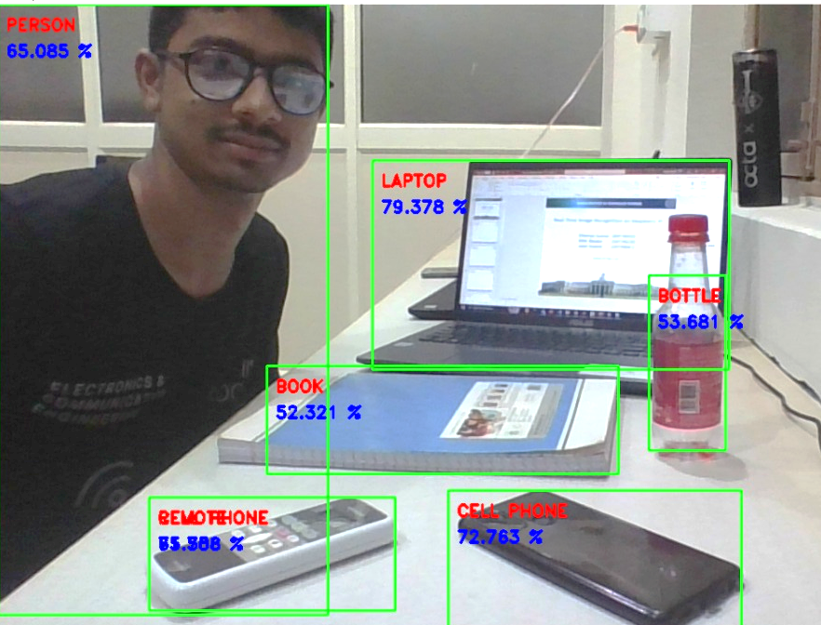
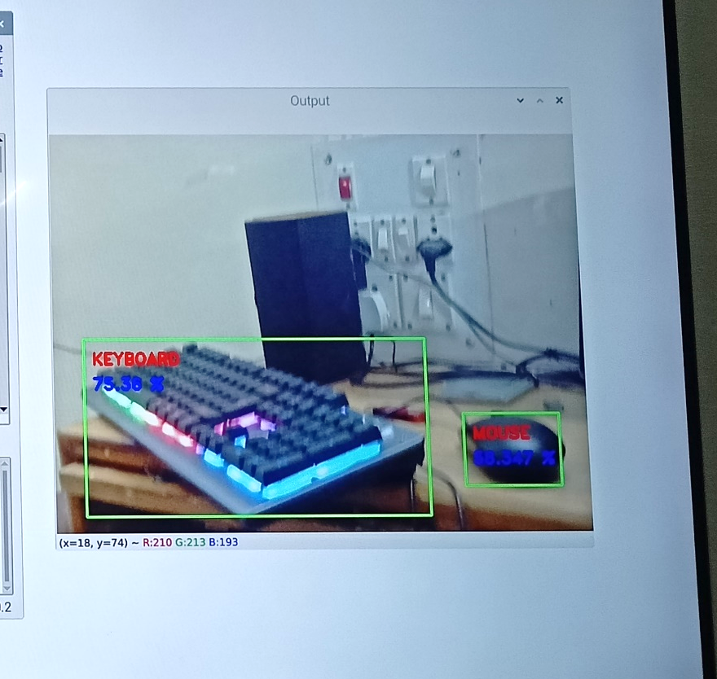
Results

Slide 14
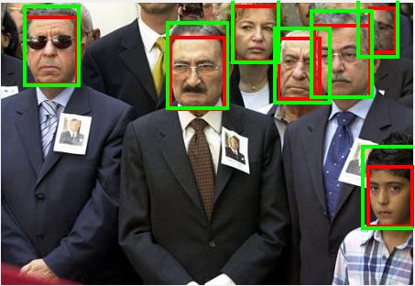
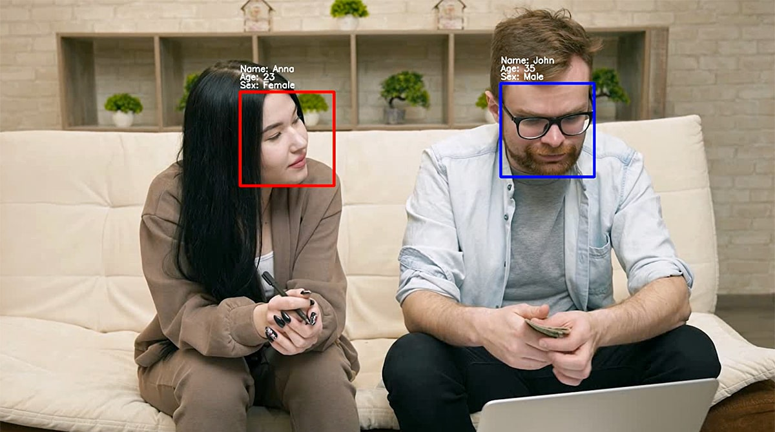
Future Work
Face Detection
In the future we will going to add Face recognition and improve our database

Slide 15
THANKYOU

